Slide 1
NB Gardens AEM Project
Scott westover & Brandon lehman

Slide 2
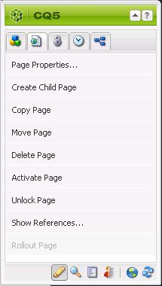
AEM
Adobe Experience Manager
part of The Marketing Cloud
Web Content Management System
CQ5 - In Browser interface

Slide 3
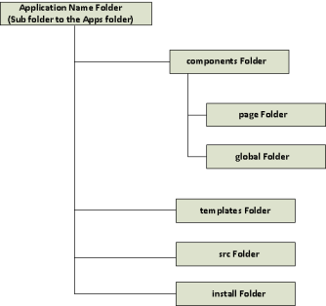
Background
Continuing the NB Gardens legacy
Web Based Project
Structured with AEM
Database connection

Slide 4

Project Overview
Login to either an Admin or User account
User | Admin
View all products | Create a product
View all customizable items | Modify any product
Sort by any criteria | Delete any product

Slide 5
Project Setup
MySQL Database
Eclipse
Git
Maven
Site layout
Site map
Site design

Slide 6
Issues and Problems
Collaboration and Eclipse
Uploading to local instance did not work
Tried using git plugin and aem plugin
AEM
Groups and user
User can go to admin pages

Slide 7
Solutions
Used package creator in AEM
Git to pass single files and packages
Database of users
Connect to one instance of AEM

Slide 9
Questions?

